Slide 1
The Design of Everyday Things
Don Norman
Taylor M Grant, Gaurav Thakur

Slide 2
The Gulfs of Execution and Evaluation
When we tackle a problem we face two gulfs in the process of tackling the problem.
The Gulf of Execution: This is when we try to understand the problem and we create a plan on how we can tackle the problem.
The Gulf of Evaluation: This is done after we perform the action to tackle the problem. This is where we evaluate that have we achieved the desired result.
The job of a designer is to help the user bridge these gulfs and to be able to achieve the results that the user wishes for.

Slide 3
Seven Stages of Action
Goal: decide the goal that is to be achieved.
Plan: create a plan to achieve it.
Specify: specify the sequence of the action.
Perform: perform the action.
Perceive: get input from the world.
Interpret: understand the input.
Compare: check if the goal is achieved.
What do I want to accomplish?
PLAN
COMPARE
SPECIFY
INTERPRET
PERFORM
PERCEIVE
WORLD

Slide 4
Human cognition and emotion
The brain is a very complex system which is still subject to many researches. But Don Norman says that the processing that the brain is able to do can be classified in three different levels. Each of this level responsible for different types of responses but they all work in concert to complete the task of processing information.
The Three Level of Processing are:
Visceral Level
Behavioral Level
Reflective Level

Slide 5
Visceral Level
This is the most basic level of processing. The instinctive reaction we have is caused by the visceral level. These reaction are what we consider to be the reaction of what we call as “The Lizard Brain” .These are our reactions to a piece of information we receive rather than our understanding. A novel character we like dying causes us to hate the reason for that character's death, or while watching a scary movie we get startled by the jump scares.

Slide 6
Behavioral Level
This is where we have the skills that we have cultivated and learned. This is what we have what we can call “ Muscle Memory ”.These are the actions we don't perform with the intent to do them but are just our reactions to the environment and other knowledge of knowing what something is used for because we have used it before.

Slide 7
Reflective Level
This is the highest cognitive part of conscious cognition. This is where we perform the act that we call thinking. This is the level that looks back at the actions we have performed and then analyzes them to create further understanding and affect the future decision-making process.

Slide 8
Seven Stages of Action & Three Levels of Processing

Slide 9
REFLECTIVE
What do I want to accomplish?
PLAN
COMPARE
BEHAVIORAL
SPECIFY
INTERPRET
VISCERAL
PERFORM
PERCEIVE
WORLD

Slide 10
Implications

Slide 11
Implications
People as Storytellers
Blaming the Wrong Things
Learned Helplessness
Positive Psychology
Falsely Blaming Yourself
People tend to look for cause-event pairings and form stories to explain what they are doing.
A conceptual model is a form of a story
Without the presence of explanatory information incorrect conceptual models are formed and incorrect usage would then happen

Slide 12
Implications
People as Storytellers
Blaming the Wrong Things
Learned Helplessness
Positive Psychology
Falsely Blaming Yourself
People tend to find cause-effect relationships even if one doesn’t exist
If one performs an action and an event happens people will associate the two
If one performs an expecting an event and it doesn’t happen, they assume they are performing the actions incorrectly

Slide 13
Implications
People as Storytellers
Blaming the Wrong Things
Learned Helplessness
Positive Psychology
Falsely Blaming Yourself
A person repeatedly fails at a task and decides that task cannot be completed by them
Typically Seen in the technology and math field

Slide 14
Implications
People as Storytellers
Blaming the Wrong Things
Learned Helplessness
Positive Psychology
Falsely Blaming Yourself
Have an optimistic outlook
Failure -> Learning Experience
Failure can be used as a tool in design, used to improve designs of tools and visualizations
“Fail often, fail fast”

Slide 15
Implications
People as Storytellers
Blaming the Wrong Things
Learned Helplessness
Positive Psychology
Falsely Blaming Yourself
A person fails at a task and blames themselves for failing at the task
In certain situations a person will fail due to a mistake but one that could have been prevented due to design choices
We still fail at task due to our own error

Slide 16
How Technology Can Accommodate Human Behavior

Slide 17
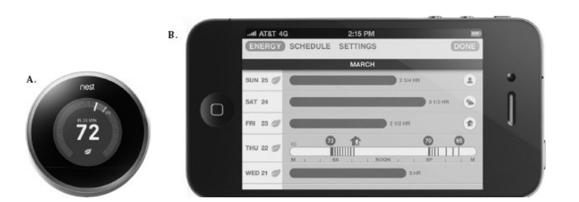

Slide 18
Seven Stages of Action

Slide 19
What do I want to accomplish?
What Are Alternatives?
Is this Okay?
What Can I Do?
What Does it Mean?
FEEDFORWARD
FEEDBACK
How Do I Do it?
What Happened?
WORLD

Slide 20


